Slide 1
Flights Delay data
Presented by:
ANDREWS HIMAKIRAN .P

Slide 2
What is EDA?
Exploratory data analysis (EDA) is a term for certain kinds of initial analysis and findings done with data sets, usually early on in an analytical process. Some experts describe it as “taking a peek” at the data to understand more about what it represents and how to apply it. Exploratory data analysis is often a precursor to other kinds of work with statistics and data.

Slide 3
Flights delay data case study
Relavant information about the data:
The data is related with delay of flights basing on various conditions like Air delay, departure delay,late aircraft delay,weather delay, security delay, air system delay, arrival delay etc.
Objective:
The objective is to find the flights which are delayed and by what time they have been delayed.

Slide 4
Variable Description:
Parameter | Description
Year | Represents the year(Numeric)
Month | Represents the month(Numeric)
Day | Represents the particular day(Numeric)
Day of week | Corresponds to the particular day of week(Numeric)
Airline | Represents the Airline(Categorical)
Flight Number | Number of the particular flight(Numeric)
Tail Number | Represents the tail number of the flight(Categorical)
Origin Airport | From which airport the flight starts(Categorical)
Destination Airport | To which airport the flight reaches(Categorical)

Slide 5
Parameter | Description
Scheduled Departure | Corresponds to the actual time of departure of the flight(Numeric)
Departure Time | Represents the time taken to reach the destination(Numeric)
Departure Delay | By how much time a particular flight has delayed(Numeric)
Scheduled Time | Represents the actual scheduled time(Numeric)
Elapsed Time | Corresponds to the time by which flight has delayed(Numeric)
Air time | Represents the travelling time(Numeric)
Distance | Represents the distance(Numeric)
Scheduled Arrival | Actual time of arrival(Numeric)
Arrival Time | Reaching time(Numeric)
Arrival Delay | By what time the flight arrived late(Numeric)
Diverted | Represents the number of diverted flights(Numeric)

Slide 6
Parameter | Description
Cancelled | Represents the number of cancelled flights(Numeric)
Cancellation Reason | Corresponds the reason by which the flight has cancelled(Categorical)
Air system delay | Represents the air system delay(Numeric)
Security Delay | Delay corresponds to delay because of security breach(Numeric)
Airline delay | Corresponds to the delay with respect to particular airline(Numeric)
Late Aircraft delay | Delay occurred due to late in the aircraft(Numeric)
Weather Delay | Represents the delay because of weather(Numeric)

Slide 7
Number of Columns and Rows
The data set consists of :
Rows – 10,48,576
Columns – 31 ( A to AE )

Slide 8
Loading the dataset into mysql
Inorder to load the data which is excel data into Mysql first we need to convert the same into CSV format.
The CSV format (file) has to be uploaded into MySql by writing the CREATE TABLE command which is as follows:
Create table FlightsDelay(YEAR int,MONTH int, DAY int,
DAY_OF_WEEK int,AIRLINE char(10),FLIGHT_NUMBER int, TAIL_NUMBER varchar(10),ORIGIN_AIRPORT char(10),
DESTINATION_AIRPORT char(10),
SCHEDULED_DEPARTURE int,DEPARTURE_TIME int,DEPARTURE_DELAY int,TAXI_OUT int,WHEELS_OFFint,SCHEDULED_TIME int,ELAPSED_TIME int,
AIR_TIME int, DISTANCE int, WHEELS_ON int, TAXI_IN int, SCHEDULED_ARRIVAL int,ARRIVAL_TIME int, ARRIVAL_DELAY int,DIVERTED int,CANCELLED int, CANCELLATION_REASON char(10),
AIR_SYSTEM_DELAY int, SECURITY_DELAY int, AIRLINE_DELAY int,LATE_AIRCRAFT_DELAY int, WEATHER_DELAY int);

Slide 9
Load data infile command
LOAD DATA INFILE
'C:\\Users\\ANDREWS HIMA KIRAN\\Desktop\\flightsdelaydata.csv'
INTO TABLE flightsdelay
FIELDS TERMINATED BY ','
ENCLOSED BY '"‘
LINES TERMINATED BY '\n‘
IGNORE 1 ROWS;

Slide 10
Total number of departure delayed flights
select count(*) from flightsdelay where DEPARTURE_DELAY>0;
417074
Total number of arrival delayed flights
select count(*) from flightsdelay where ARRIVAL_DELAY>0;
424129
Total number of Cancelled flights
select count(*) from flightsdelay where CANCELLED=1;
40527
Number of Unique ORIGIN_AIRPORT
select distinct ORIGIN_AIRPORT from flightsdelay;
315
Number of Unique DESTINATION_AIRPORT
select distinct DESTINATION_AIRPORT from flightsdelay;
315

Slide 11
Number of unique Airlines
select distinct AIRLINE from flightsdelay;
AS
AA
US
DL
NK
UA
HA
B6
OO
EV
MQ
F9
WN
VX
Total = 14

Slide 12
Number of unique FLIGHT_NUMBER
select distinct FLIGHT_NUMBER from flightsdelay;
6522
Number of unique TAIL_NUMBER
select distinct TAIL_NUMBER from flightsdelay;
4523
Number of unique YEAR
select distinct YEAR from flightsdelay;
YEAR
2015
Number of unique MONTH
select distinct MONTH from flightsdelay;
MONTH
'1'
'2'
'3'

Slide 13
Number of unique days
select distinct DAY from flightsdelay;
DAY
'1'
'2'
'3'
'4'
'5'
'6'
'7'
'8'
'9'
'10'
'11'
'12'
'13'
'14'
'15'
'16'
'17'
'18'
'19'
'20'
'21'
'22'
'23'
'24'
'25'
'26'
'27'
'28'
'29'
'30'
'31'

Slide 14
Number of unique days of a week
DAY_OF_WEEK
'4'
'5'
'6'
'7'
'1'
'2'
'3‘
Number of Diverted flights
select count(*) from flightsdelay where DIVERTED=1;
count(*)
'2544‘
Delay time of flights due to AIR_SYSTEM_DELAY
select sum(AIR_SYSTEM_DELAY) from flightsdelay;
sum(AIR_SYSTEM_DELAY)
'3129132'

Slide 15
Delay time of flights due to SECURITY_DELAY
select sum(SECURITY_DELAY) from flightsdelay;
sum(SECURITY_DELAY)
'13101‘
Delay time of flights due to AIRLINE_DELAY
select sum(AIRLINE_DELAY) from flightsdelay;
sum(AIRLINE_DELAY)
'4160027‘
Delay time of flights due to LATE_AIRCRAFT_DELAY
select sum(LATE_AIRCRAFT_DELAY) from flightsdelay;
sum(LATE_AIRCRAFT_DELAY)
'5238195‘
Delay time of flights due to WEATHER_DELAY
select sum(WEATHER_DELAY) from flightsdelay;
sum(WEATHER_DELAY)
'810195‘
Top 3 AIRINES with longest DISTANCE
select distinct AIRLINE from flightsdelay where DISTANCE > 4000;
AIRLINE
'DL'
'UA'
'HA'

Slide 16
Airline with high departure delay
select distinct AIRLINE from flightsdelay where DEPARTURE_DELAY > 1500;
AIRLINE
'AA‘
Airline with high arrival delay
select distinct AIRLINE from flightsdelay where ARRIVAL_DELAY > 1500;
AIRLINE
'AA‘
Airlines with high AIR_SYSTEM_DELAY
select distinct AIRLINE from flightsdelay where AIR_SYSTEM_DELAY > 800;
# AIRLINE
'OO'
'AA'
Airlines with high SECURITY_DELAY
select distinct AIRLINE from flightsdelay where SECURITY_DELAY > 200;
# AIRLINE
'NK'
'DL'
Airline with high AIRLINE_DELAY
select distinct AIRLINE from flightsdelay where AIRLINE_DELAY > 1500;
# AIRLINE
'AA‘
Airline with high LATE_AIRCRAFT_DELAY
select distinct AIRLINE from flightsdelay where LATE_AIRCRAFT_DELAY > 1000;
# AIRLINE
'AA'
Airline with high WEATHER_DELAY
select distinct AIRLINE from flightsdelay where WEATHER_DELAY > 1100;
# AIRLINE
'DL'
'MQ'

Slide 17
Distinct Airlines with their Flight numbers which were cancelled
select distinct AIRLINE,FLIGHT_NUMBER from flightsdelay where CANCELLED=1;
10236
Number of Flights with maximum Airtime
select count(FLIGHT_NUMBER) from flightsdelay where AIR_TIME>650;
# count(FLIGHT_NUMBER)
'40‘
Number of Flights with maximum Elapsed time
select count(FLIGHT_NUMBER) from flightsdelay where ELAPSED_TIME>750;
# count(FLIGHT_NUMBER)
'1'

Slide 18
Entire information of the data set
# Column Count Non-Null Dtype
0 YEAR 1048575 non-null int64 1 MONTH 1048575 non-null int64
2 DAY 1048575 non-null int64 3 DAY_OF_WEEK 1048575 non-null int64 4 AIRLINE 1048575 non-null object 5 FLIGHT_NUMBER 1048575 non-null int64
6 TAIL_NUMBER 1040825 non-null object 7 ORIGIN_AIRPORT 1048575 non-null object 8 DESTINATION_AIRPORT 1048575 non-null object 9 SCHEDULED_DEPARTURE 1048575 non-null int64 10 DEPARTURE_TIME 1009060 non-null float64
11 DEPARTURE_DELAY 1009060 non-null float64 12 TAXI_OUT 1008346 non-null float64

Slide 19
# Column Count Non-Null Dtype
13 WHEELS_OFF 1008346 non-null float64 14 SCHEDULED_TIME 1048573 non-null float64 15 ELAPSED_TIME 1005504 non-null float64 16 AIR_TIME 1005504 non-null float64 17 DISTANCE 1048575 non-null int64 18 WHEELS_ON 1007279 non-null float64
19 TAXI_IN 1007279 non-null float64 20 SCHEDULED_ARRIVAL 1048575 non-null int64 21 ARRIVAL_TIME 1007279 non-null float64 22 ARRIVAL_DELAY 1005504 non-null float64 23 DIVERTED 1048575 non-null int64 24 CANCELLED 1048575 non-null int64
25 CANCELLATION_REASON 40527 non-null object 26 AIR_SYSTEM_DELAY 228528 non-null float64 27 SECURITY_DELAY 228528 non-null float64

Slide 20
# Column Count Non-Null Dtype
28 AIRLINE_DELAY 228528 non-null float64 29 LATE_AIRCRAFT_DELAY 228528 non-null float64 30 WEATHER_DELAY 228528 non-null float64
dtypes: float64(16),
int64(10),
object(5)
memory usage: 248.0+ MB

Slide 21
Categorical columns
Airline
Tail Number
Origin Airport
Destination Airport
Cancellation Reason

Slide 22
Numerical columns
Year
Month
Day
Day of Week
Flight Number
Scheduled Departure
Departure Time
Departure Delay
Taxi out
Wheels Off
Scheduled Time
Elapsed Time
Air Time
Distance
Wheels On
Taxi In
Scheduled Arrival

Slide 23
Arrival Time
Arrival Delay
Diverted
Cancelled
Cancellation Reason
Air System Delay
Security Delay
Airline Delay
Late Aircraft Delay
Weather Delay

Slide 24
Count of each column
YEAR 1048575
MONTH 1048575
DAY 1048575
DAY_OF_WEEK 1048575
AIRLINE 1048575
FLIGHT_NUMBER 1048575
TAIL_NUMBER 1040825
ORIGIN_AIRPORT 1048575
DESTINATION_AIRPORT 1048575 SCHEDULED_DEPARTURE 1048575 DEPARTURE_TIME 1009060
DEPARTURE_DELAY 1009060
TAXI_OUT 1008346

Slide 25
WHEELS_OFF 1008346
SCHEDULED_TIME 1048573
ELAPSED_TIME 1005504
AIR_TIME 1005504
DISTANCE 1048575
WHEELS_ON 1007279
TAXI_IN 1007279
SCHEDULED_ARRIVAL 1048575
ARRIVAL_TIME 1007279
ARRIVAL_DELAY 1005504
DIVERTED 1048575
CANCELLED 1048575
CANCELLATION_REASON 40527
AIR_SYSTEM_DELAY 228528
SECURITY_DELAY 228528
AIRLINE_DELAY 228528
LATE_AIRCRAFT_DELAY 228528
WEATHER_DELAY 228528
dtype: int64

Slide 26
flights_missing.dtypes
YEAR bool
MONTH bool
DAY bool DAY_OF_WEEK bool
AIRLINE bool
FLIGHT_NUMBER bool
TAIL_NUMBER bool
ORIGIN_AIRPORT bool
DESTINATION_AIRPORT bool
SCHEDULED_DEPARTURE bool
DEPARTURE_TIME bool
DEPARTURE_DELAY bool
TAXI_OUT bool
WHEELS_OFF bool
SCHEDULED_TIME bool
ELAPSED_TIME bool
AIR_TIME bool
DISTANCE bool
WHEELS_ON bool
TAXI_IN bool
SCHEDULED_ARRIVAL bool
ARRIVAL_TIME bool
ARRIVAL_DELAY bool

Slide 27
DIVERTED bool
CANCELLED bool CANCELLATION_REASON bool AIR_SYSTEM_DELAY bool
SECURITY_DELAY bool
AIRLINE_DELAY bool LATE_AIRCRAFT_DELAY bool
WEATHER_DELAY bool
dtype: object

Slide 28
Counting the number of missing values
flights_missing.sum()
YEAR 0
MONTH 0
DAY 0 DAY_OF_WEEK 0
AIRLINE 0
FLIGHT_NUMBER 0
TAIL_NUMBER 7750
ORIGIN_AIRPORT 0
DESTINATION_AIRPORT 0
SCHEDULED_DEPARTURE 0
DEPARTURE_TIME 39515
DEPARTURE_DELAY 39515
TAXI_OUT 40229
WHEELS_OFF 40229
SCHEDULED_TIME 2
ELAPSED_TIME 43071
AIR_TIME 43071
DISTANCE 0
WHEELS_ON 41296
TAXI_IN 41296
SCHEDULED_ARRIVAL 0
ARRIVAL_TIME 41296
ARRIVAL_DELAY 43071
DIVERTED 0

Slide 29
CANCELLED 0 CANCELLATION_REASON 1008048 AIR_SYSTEM_DELAY 820047 SECURITY_DELAY 820047 AIRLINE_DELAY 820047 LATE_AIRCRAFT_DELAY 820047 WEATHER_DELAY 820047
dtype: int64

Slide 30
Describing numerical columns
flights.SCHEDULED_DEPARTURE.describe()
Count 1.048575e+06
mean 1.322632e+03
std 4.707748e+02
min 1.000000e+00
25% 9.200000e+02
50% 1.319000e+03
75% 1.720000e+03
max 2.359000e+03
Name: SCHEDULED_DEPARTURE, dtype: float64
flights.DEPARTURE_TIME.describe()
count 1.009060e+06
mean 1.333705e+03
std 4.827415e+02
min 1.000000e+00
25% 9.280000e+02
50% 1.329000e+03
75% 1.731000e+03
Max 2.400000e+03
Name: DEPARTURE_TIME, dtype: float64

Slide 31
flights.DEPARTURE_DELAY.describe()
count 1.009060e+06
mean 1.133485e+01
std 3.922372e+01
Min -6.100000e+01
25% -5.000000e+00
50% -1.000000e+00
75% 1.100000e+01
max 1.988000e+03
Name: DEPARTURE_DELAY, dtype: float64
flights.TAXI_OUT.describe()
count 1.008346e+06
mean 1.665380e+01
std 1.007006e+01
min 1.000000e+00
25% 1.100000e+01
50% 1.400000e+01
75% 1.900000e+01
max 2.250000e+02
Name: TAXI_OUT, dtype: float64

Slide 32
flights.WHEELS_OFF.describe()
count 1.008346e+06
mean 1.357382e+03
std 4.830351e+02
min 1.000000e+00
25% 9.440000e+02
50% 1.342000e+03
75% 1.745000e+03
max 2.400000e+03
Name: WHEELS_OFF, dtype: float64
flights.SCHEDULED_TIME.describe()
count 1.048573e+06
mean 1.402526e+02
std 7.463458e+01
min 2.000000e+01
25% 8.500000e+01
50% 1.220000e+02
75% 1.730000e+02
max 7.180000e+02
Name: SCHEDULED_TIME, dtype: float64

Slide 33
flights.ELAPSED_TIME.describe()
count 1.005504e+06
mean 1.369381e+02
std 7.394818e+01
min 1.500000e+01
25% 8.200000e+01
50% 1.190000e+02
75% 1.690000e+02
max 7.660000e+02
Name: ELAPSED_TIME, dtype: float64
flights.AIR_TIME.describe()
count 1.005504e+06
mean 1.127477e+02
std 7.186952e+01
min 7.000000e+00
25% 6.000000e+01
50% 9.400000e+01
75% 1.440000e+02
max 6.870000e+02
Name: AIR_TIME, dtype: float64

Slide 34
flights.DISTANCE.describe()
count 1.048575e+06
mean 8.034077e+02
std 5.942362e+02
min 3.100000e+01
25% 3.680000e+02
50% 6.410000e+02
75% 1.046000e+03
max 4.983000e+03
Name: DISTANCE, dtype: float64
flights.WHEELS_ON.describe()
count 1.007279e+06
mean 1.485932e+03
std 5.033515e+02
min 1.000000e+00
25% 1.110000e+03
50% 1.516000e+03
75% 1.911000e+03
max 2.400000e+03
Name: WHEELS_ON, dtype: float64

Slide 35
flights.TAXI_IN.describe()
count 1.007279e+06
mean 7.549438e+00
std 6.352526e+00
min 1.000000e+00
25% 4.000000e+00
50% 6.000000e+00
75% 9.000000e+00
max 2.020000e+02
Name: TAXI_IN, dtype: float64
flights.SCHEDULED_ARRIVAL.describe()
count 1.048575e+06
mean 1.504820e+03
std 4.865613e+02
min 1.000000e+00
25% 1.120000e+03
50% 1.524000e+03
75% 1.915000e+03
max 2.359000e+03
Name: SCHEDULED_ARRIVAL, dtype: float64

Slide 36
flights.ARRIVAL_TIME.describe()
count 1.007279e+06
mean 1.492204e+03
std 5.071090e+02
min 1.000000e+00
25% 1.115000e+03
50% 1.521000e+03
75% 1.917000e+03
max 2.400000e+03
Name: ARRIVAL_TIME, dtype: float64
flights.ARRIVAL_DELAY.describe()
count 1.005504e+06
mean 7.612191e+00
std 4.209367e+01
min -8.200000e+01
25% -1.200000e+01
50% -3.000000e+00
75% 1.200000e+01
max 1.971000e+03
Name: ARRIVAL_DELAY, dtype: float64

Slide 37
flights.DIVERTED.describe()
count 1.048575e+06
mean 2.426150e-03
std 4.919620e-02
min 0.000000e+00
25% 0.000000e+00
50% 0.000000e+00
75% 0.000000e+00
max 1.000000e+00
Name: DIVERTED, dtype: float64
flights.CANCELLED.describe()
count 1.048575e+06
mean 3.864960e-02
std 1.927585e-01
min 0.000000e+00
25% 0.000000e+00
50% 0.000000e+00
75% 0.000000e+00
max 1.000000e+00
Name: CANCELLED, dtype: float64

Slide 38
flights.AIR_SYSTEM_DELAY.describe()
count 228528.000000
mean 13.692554
std 25.524897
min 0.000000
25% 0.000000
50% 4.000000
75% 19.000000
max 830.000000
Name: AIR_SYSTEM_DELAY, dtype: float64
flights.SECURITY_DELAY.describe()
count 228528.000000
mean 0.057328
std 1.779647
min 0.000000
25% 0.000000
50% 0.000000
75% 0.000000
max 241.000000
Name: SECURITY_DELAY, dtype: float64

Slide 39
flights.AIRLINE_DELAY.describe()
count 228528.000000
mean 18.203577
std 46.323146
min 0.000000
25% 0.000000
50% 2.000000
75% 18.000000
max 1971.000000
Name: AIRLINE_DELAY, dtype: float64
flights.LATE_AIRCRAFT_DELAY.describe()
count 228528.000000
mean 22.921458
std 41.888498
min 0.000000
25% 0.000000
50% 4.000000
75% 29.000000
max 1313.000000
Name: LATE_AIRCRAFT_DELAY, dtype: float64

Slide 40
flights.WEATHER_DELAY.describe()
count 228528.000000
mean 3.545277
std 23.611555
min 0.000000
25% 0.000000
50% 0.000000
75% 0.000000
max 1152.000000
Name: WEATHER_DELAY, dtype: float64

Slide 41
To find the range of each column
print("range is",flights.SCHEDULED_DEPARTURE.max()-flights.SCHEDULED_DEPARTURE.min())
range is 2358
print("range is",flights.DEPARTURE_TIME.max()-flights.DEPARTURE_TIME.min())
range is 2399.0
print("range is",flights.DEPARTURE_DELAY.max()-flights.DEPARTURE_DELAY.min())
range is 2049.0
print("range is",flights.TAXI_OUT.max()-flights.TAXI_OUT.min())
range is 224.0
print("range is",flights.WHEELS_OFF.max()-flights.WHEELS_OFF.min())
range is 2399.0
print("range is",flights.SCHEDULED_TIME.max()-flights.SCHEDULED_TIME.min())
range is 698.0
print("range is",flights.ELAPSED_TIME.max()-flights.ELAPSED_TIME.min())
range is 751.0
print("range is",flights.AIR_TIME.max()-flights.AIR_TIME.min())
range is 680.0
print("range is",flights.DISTANCE.max()-flights.DISTANCE.min())
range is 4952
print("range is",flights.WHEELS_ON.max()-flights.WHEELS_ON.min())
range is 2399.0
print("range is",flights.TAXI_IN.max()-flights.TAXI_IN.min())
range is 201.0

Slide 42
print("range is",flights.SCHEDULED_ARRIVAL.max()-flights.SCHEDULED_ARRIVAL.min())
range is 2358
print("range is",flights.ARRIVAL_TIME.max()-flights.ARRIVAL_TIME.min())
range is 2399.0
print("range is",flights.ARRIVAL_DELAY.max()-flights.ARRIVAL_DELAY.min())
range is 2053.0
print("range is",flights.DIVERTED.max()-flights.DIVERTED.min())
range is 1
print("range is",flights.CANCELLED.max()-flights.CANCELLED.min())
range is 1
print("range is",flights.AIR_SYSTEM_DELAY.max()-flights.AIR_SYSTEM_DELAY.min())
range is 830.0
print("range is",flights.SECURITY_DELAY.max()-flights.SECURITY_DELAY.min())
range is 241.0
print("range is",flights.AIRLINE_DELAY.max()-flights.AIRLINE_DELAY.min())
range is 1971.0
print("range is",flights.LATE_AIRCRAFT_DELAY.max()-flights.LATE_AIRCRAFT_DELAY.min())
range is 1313.0
print("range is",flights.WEATHER_DELAY.max()-flights.WEATHER_DELAY.min())
range is 1152.0

Slide 43
To find the variance
flights.var()
YEAR 0.000000e+00
MONTH 4.972376e-01
DAY 7.613707e+01
DAY_OF_WEEK 3.997743e+00
FLIGHT_NUMBER 3.236998e+06
SCHEDULED_DEPARTURE 2.216289e+05
DEPARTURE_TIME 2.330394e+05
DEPARTURE_DELAY 1.538500e+03
TAXI_OUT 1.014061e+02
WHEELS_OFF 2.333229e+05
SCHEDULED_TIME 5.570320e+03
ELAPSED_TIME 5.468333e+03
AIR_TIME 5.165227e+03
DISTANCE 3.531167e+05
WHEELS_ON 2.533627e+05
TAXI_IN 4.035459e+01
SCHEDULED_ARRIVAL 2.367419e+05
ARRIVAL_TIME 2.571596e+05
ARRIVAL_DELAY 1.771877e+03
DIVERTED 2.420266e-03
CANCELLED 3.715584e-02
AIR_SYSTEM_DELAY 6.515204e+02
SECURITY_DELAY 3.167144e+00
AIRLINE_DELAY 2.145834e+03
LATE_AIRCRAFT_DELAY 1.754646e+03
WEATHER_DELAY 5.575055e+02
dtype: float64

Slide 44
Finding skewness
flights.skew()
YEAR 0.000000
MONTH 0.510191
DAY 0.251203
DAY_OF_WEEK 0.015272
FLIGHT_NUMBER 0.756329
SCHEDULED_DEPARTURE 0.065454
DEPARTURE_TIME 0.023281
DEPARTURE_DELAY 7.680941
TAXI_OUT 3.476724
WHEELS_OFF -0.003586
SCHEDULED_TIME 1.388263
ELAPSED_TIME 1.390448
AIR_TIME 1.430891
DISTANCE 1.467033
WHEELS_ON -0.312787
TAXI_IN 6.249590
SCHEDULED_ARRIVAL -0.226830
ARRIVAL_TIME -0.352981
ARRIVAL_DELAY 6.436522
DIVERTED 20.228181
CANCELLED 4.786832
AIR_SYSTEM_DELAY 5.902266
SECURITY_DELAY 65.227468
AIRLINE_DELAY 9.505142
LATE_AIRCRAFT_DELAY 4.463671
WEATHER_DELAY 16.658359
dtype: float64

Slide 45
Finding Kurtosis
flights.kurtosis()
YEAR 0.000000
MONTH -0.889180
DAY -1.193665
DAY_OF_WEEK -1.220955
FLIGHT_NUMBER -0.527038
SCHEDULED_DEPARTURE -1.009875
DEPARTURE_TIME -0.959865
DEPARTURE_DELAY 133.655300
TAXI_OUT 22.140311
WHEELS_OFF -0.896257
SCHEDULED_TIME 2.288575
ELAPSED_TIME 2.379997
AIR_TIME 2.463381
DISTANCE 2.570231
WHEELS_ON -0.427039
TAXI_IN 78.794361
SCHEDULED_ARRIVAL -0.587927
ARRIVAL_TIME -0.339403
ARRIVAL_DELAY 101.613339
DIVERTED 407.180087
CANCELLED 20.913801
AIR_SYSTEM_DELAY 75.408897
SECURITY_DELAY 6238.552724
AIRLINE_DELAY 177.500102
LATE_AIRCRAFT_DELAY 45.248688
WEATHER_DELAY 451.881007
dtype: float64

Slide 46
Unique values in columns
flights.YEAR.unique()
array([2015], dtype=int64)
flights.MONTH.unique()
array([1, 2, 3], dtype=int64)
flights.DAY.unique()
array([ 1, 2, 3, 4, 5, 6, 7, 8, 9, 10, 11, 12, 13, 14, 15, 16, 17, 18, 19, 20, 21, 22, 23, 24, 25, 26, 27, 28, 29, 30, 31], dtype=int64)
flights.DAY_OF_WEEK.unique()
array([4, 5, 6, 7, 1, 2, 3], dtype=int64)
flights.AIRLINE.unique()
array(['AS', 'AA', 'US', 'DL', 'NK', 'UA', 'HA', 'B6', 'OO', 'EV', 'MQ', 'F9', 'WN', 'VX'], dtype=object)

Slide 47
Percentages of missing values in each column
flights_num_missing/len(flights)
YEAR 0.000000
MONTH 0.000000
DAY 0.000000
DAY_OF_WEEK 0.000000
AIRLINE 0.000000
FLIGHT_NUMBER 0.000000
TAIL_NUMBER 0.007391
ORIGIN_AIRPORT 0.000000 DESTINATION_AIRPORT 0.000000 SCHEDULED_DEPARTURE 0.000000
DEPARTURE_TIME 0.037684 DEPARTURE_DELAY 0.037684

Slide 48
TAXI_OUT 0.038365
WHEELS_OFF 0.038365
SCHEDULED_TIME 0.000002
ELAPSED_TIME 0.041076
AIR_TIME 0.041076
DISTANCE 0.000000
WHEELS_ON 0.039383
TAXI_IN 0.039383
SCHEDULED_ARRIVAL 0.000000
ARRIVAL_TIME 0.039383
ARRIVAL_DELAY 0.041076
DIVERTED 0.000000
CANCELLED 0.000000
CANCELLATION_REASON 0.961350
AIR_SYSTEM_DELAY 0.782059
SECURITY_DELAY 0.782059
AIRLINE_DELAY 0.782059
LATE_AIRCRAFT_DELAY 0.782059
WEATHER_DELAY 0.782059
dtype: float64

Slide 49
Percentages of missing values accurately
flights.isna().mean().round(4)*100
YEAR 0.00
MONTH 0.00
DAY 0.00
DAY_OF_WEEK 0.00
AIRLINE 0.00
FLIGHT_NUMBER 0.00
TAIL_NUMBER 0.74
ORIGIN_AIRPORT 0.00
DESTINATION_AIRPORT 0.00
SCHEDULED_DEPARTURE 0.00
DEPARTURE_TIME 3.77
DEPARTURE_DELAY 3.77
TAXI_OUT 3.84
WHEELS_OFF 3.84
SCHEDULED_TIME 0.00
ELAPSED_TIME 4.11
AIR_TIME 4.11
DISTANCE 0.00
WHEELS_ON 3.94
TAXI_IN 3 .94
SCHEDULED_ARRIVAL 0.00

Slide 50
ARRIVAL_TIME 3.94
ARRIVAL_DELAY 4.11
DIVERTED 0.00
CANCELLED 0.00
CANCELLATION_REASON 96.14
AIR_SYSTEM_DELAY 78.21
SECURITY_DELAY 78.21
AIRLINE_DELAY 78.21
LATE_AIRCRAFT_DELAY 78.21
WEATHER_DELAY 78.21
dtype: float64

Slide 51
Percentage of non missing values
1-flights.count()/len(flights)
YEAR 0.000000
MONTH 0.000000
DAY 0.000000
DAY_OF_WEEK 0.000000
AIRLINE 0 .000000
FLIGHT_NUMBER 0.000000
TAIL_NUMBER 0.007391
ORIGIN_AIRPORT 0.000000
DESTINATION_AIRPORT 0.000000
SCHEDULED_DEPARTURE 0.000000
DEPARTURE_TIME 0.037684
DEPARTURE_DELAY 0.037684
TAXI_OUT 0.038365
WHEELS_OFF 0.038365
SCHEDULED_TIME 0.000002
ELAPSED_TIME 0.041076
AIR_TIME 0.041076
DISTANCE 0.000000
WHEELS_ON 0.039383
TAXI_IN 0.039383

Slide 52
SCHEDULED_ARRIVAL 0.000000
ARRIVAL_TIME 0.039383
ARRIVAL_DELAY 0.041076
DIVERTED 0.000000
CANCELLED 0.000000
CANCELLATION_REASON 0.961350
AIR_SYSTEM_DELAY 0.782059
SECURITY_DELAY 0.782059
AIRLINE_DELAY 0.782059
LATE_AIRCRAFT_DELAY 0.782059
WEATHER_DELAY 0.782059
dtype: float64

Slide 53
Finding duplicated rows
flights.duplicated()
0 False
1 False
2 False
3 False
4 False
...
1048570 False
1048571 False
1048572 False
1048573 False
1048574 False
Length: 1048575, dtype: bool

Slide 54
Finding the sum of duplicated rows
flights.duplicated().sum()
0
This means there are zero duplicated rows in the dataset again which means there are no duplicated rows in the dataset.

Slide 55
Finding duplicated values in a particular column
flights['YEAR'].duplicated().sum()
1048574
flights['MONTH'].duplicated().sum()
1048572
flights['DAY'].duplicated().sum()
1048544
flights['DAY_OF_WEEK'].duplicated().sum()
1048568
flights['AIRLINE'].duplicated().sum()
1048561
flights['FLIGHT_NUMBER'].duplicated().sum()
1042053
flights['TAIL_NUMBER'].duplicated().sum()
1044052
flights['ORIGIN_AIRPORT'].duplicated().sum()
1048260
flights['DESTINATION_AIRPORT'].duplicated().sum()
1048260

Slide 56
flights['SCHEDULED_DEPARTURE'].duplicated().sum()
1047339
flights['DEPARTURE_TIME'].duplicated().sum()
1047140
flights['DEPARTURE_DELAY'].duplicated().sum()
1047713
flights['TAXI_OUT'].duplicated().sum()
1048395
flights['TAXI_IN'].duplicated().sum()
1048395
flights['WHEELS_OFF'].duplicated().sum()
1047141
flights['WHEELS_ON'].duplicated().sum()
1047134
flights['SCHEDULED_TIME'].duplicated().sum()
1048114
flights['SCHEDULED_ARRIVAL'].duplicated().sum()
1047222
flights['ARRIVAL_TIME'].duplicated().sum()
1047134
flights['ARRIVAL_DELAY'].duplicated().sum()
1047691
flights['AIR_SYSTEM_DELAY'].duplicated().sum()
1048179

Slide 57
flights['SECURITY_DELAY'].duplicated().sum()
1048487
flights['AIRLINE_DELAY'].duplicated().sum()
1047899
flights['LATE_AIRCRAFT_DELAY'].duplicated().sum()
1048064
flights['WEATHER_DELAY'].duplicated().sum()
1048108
flights['ELAPSED_TIME'].duplicated().sum()
1047889
flights['AIR_TIME'].duplicated().sum()
1047924
flights['DISTANCE'].duplicated().sum()
1047304
flights['DIVERTED'].duplicated().sum()
1048573
flights['CANCELLED'].duplicated().sum()
1048573
flights['CANCELLATION_REASON'].duplicated().sum()
1048570

Slide 58
Value counts of each column
pd.value_counts(flights['YEAR'])
2015 1048575
Name: YEAR, dtype: int64
pd.value_counts(flights['MONTH'])
1 469968
2 429191
3 149416
Name: MONTH, dtype: int64
pd.value_counts(flights['DAY'])
5 49180
2 49165
9 48781
4 48089
6 48024
8 46844
3 46586
1 42527
7 42056
10 32565
23 32431

Slide 59
16 32372
26 32331
19 32243
12 32191
20 31657
13 31656
27 31615
22 31190
25 30879
15 30428
11 30295
18 30030
21 28422
28 28407
24 28186
17 28147
14 28131
30 16080
29 16030
31 12037
Name: DAY, dtype: int64

Slide 60
pd.value_counts(flights['DAY_OF_WEEK'])
5 163070
1 162041
4 159800
7 148678
2 144193
3 141753
6 129040
Name: DAY_OF_WEEK, dtype: int64
pd.value_counts(flights['AIRLINE'])
WN 221586
DL 147486
EV 111206
OO 107099
AA 97549
UA 87606
US 73942
MQ 65513
B6 48157
AS 29614
NK 19612
F9 14669
HA 14133
VX 10403 Name: AIRLINE, dtype: int64

Slide 61
pd.value_counts(flights['FLIGHT_NUMBER'])
469 853
345 803
61 749
711 737
745 734
...
9320 1
6094 1
6576 1
5890 1
4005 1
Name: FLIGHT_NUMBER, Length: 6522, dtype: int64
pd.value_counts(flights['TAIL_NUMBER'])
N477HA 809
N488HA 799
N476HA 773
N485HA 767
N486HA 741
...
N19951 1
N7LHAA 1
N673US 1
N1200K 1
N27015 1
Name: TAIL_NUMBER, Length: 4522, dtype: int64

Slide 62
pd.value_counts(flights['ORIGIN_AIRPORT'])
ATL 66599
ORD 52961
DFW 50933
LAX 38473
DEN 38254
...
UST 33
BGR 22
PPG 21
ADK 20
ITH 6
Name: ORIGIN_AIRPORT, Length: 315, dtype: int64
pd.value_counts(flights['DESTINATION_AIRPORT'])
ATL 66741
ORD 53060
DFW 51037
LAX 38463
DEN 38300
...
UST 33
BGR 22
PPG 21
ADK 20
ITH 6
Name: DESTINATION_AIRPORT, Length: 315, dtype: int64

Slide 63
Connecting to Tableau
Start Tableau and under Connect, select MySQL. From the complete list of data connections
Once the Server name and the Port number is provided, click on Sign in and the data from MySQL will be loaded in Tableau

Slide 64
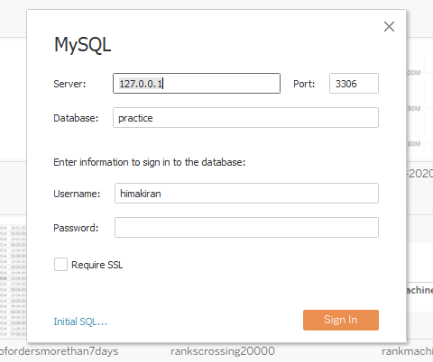
Connecting to tableau

Slide 65
VISUALISATIONS IN TABLEAU

Slide 66
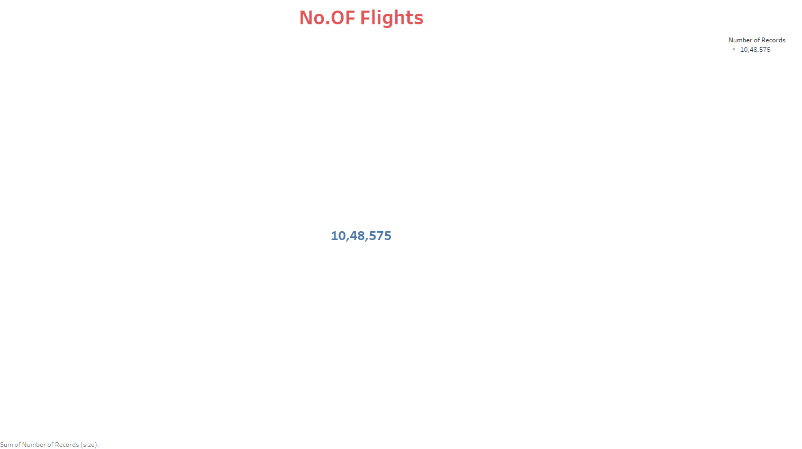
Total number of flights

Slide 67
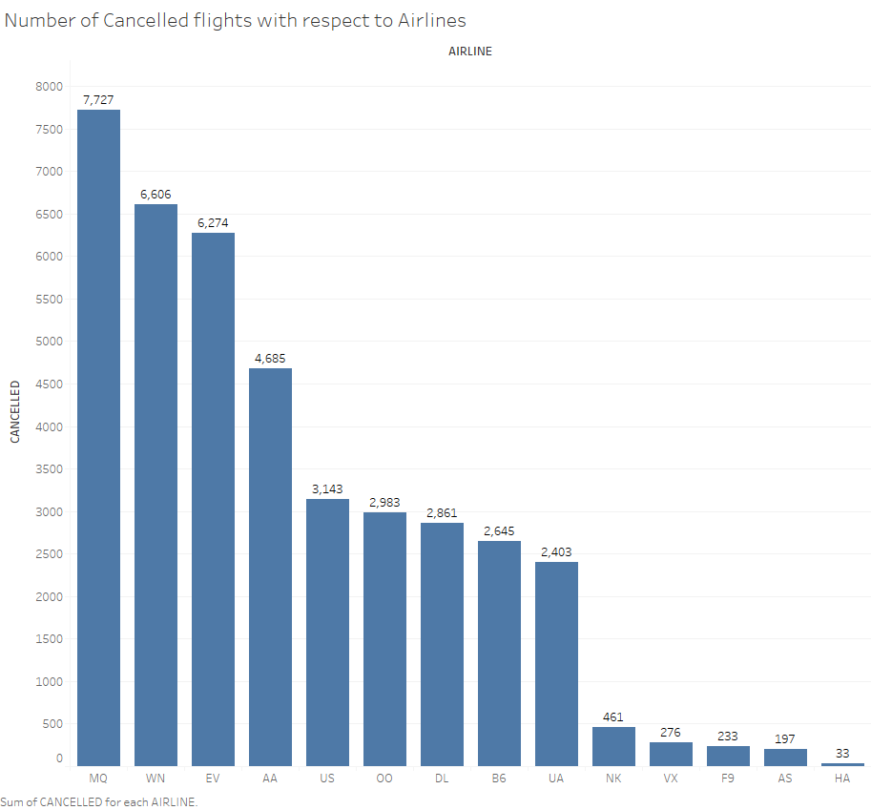
Total number of cancelled flights with respect to airlines

Slide 68
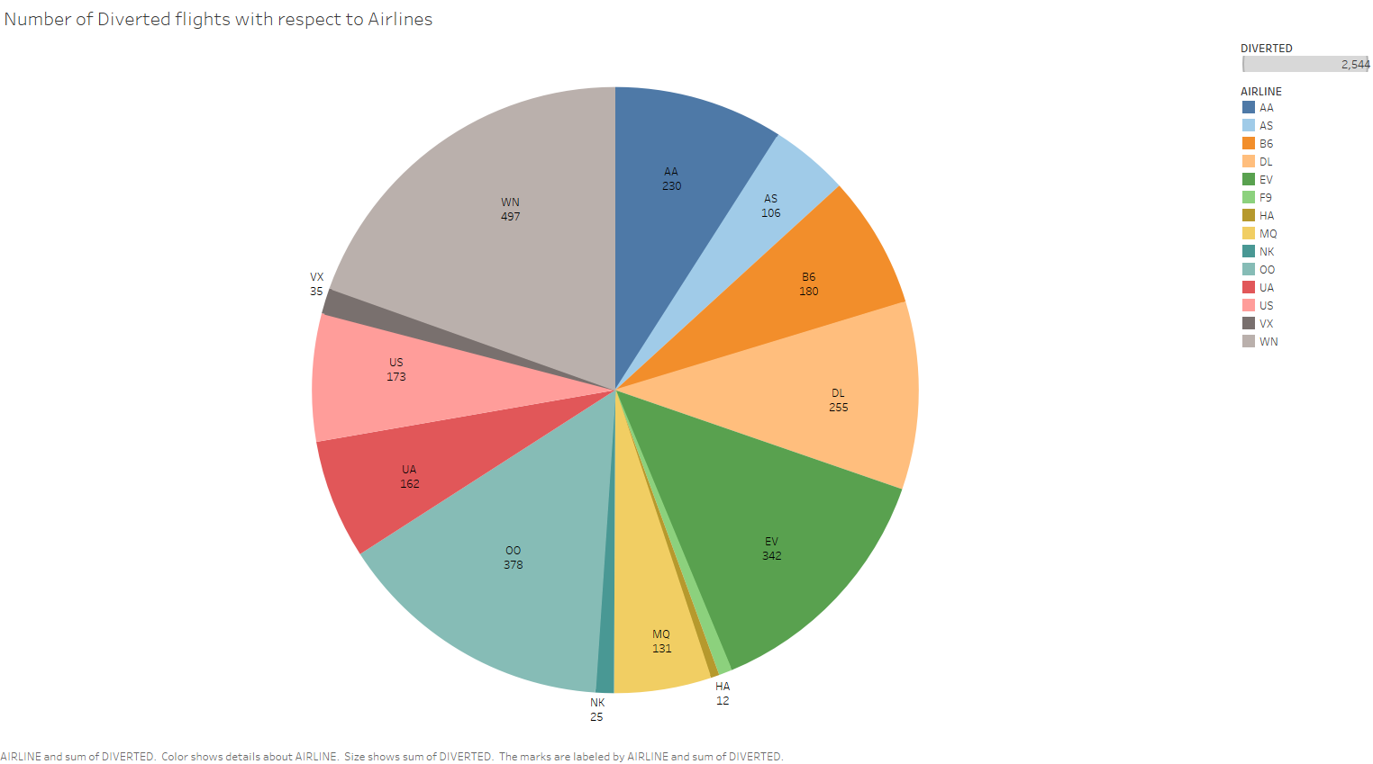
Number of diverted flights with respect to airlines

Slide 69
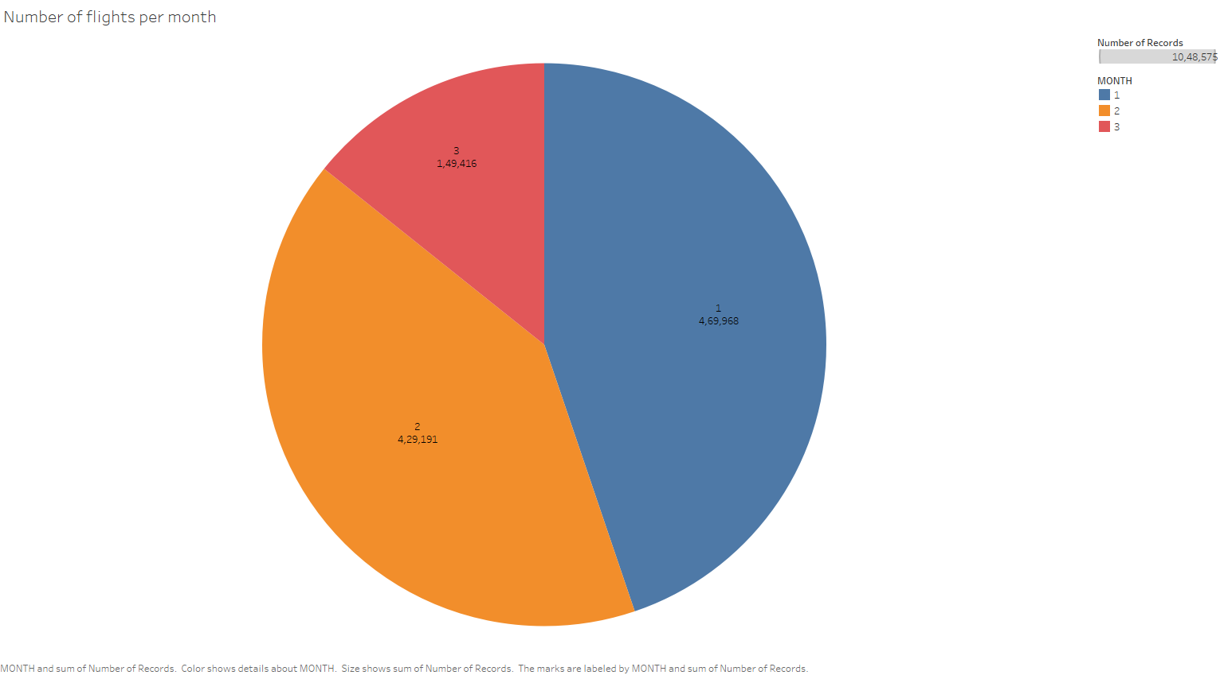
Number of flights per month

Slide 70
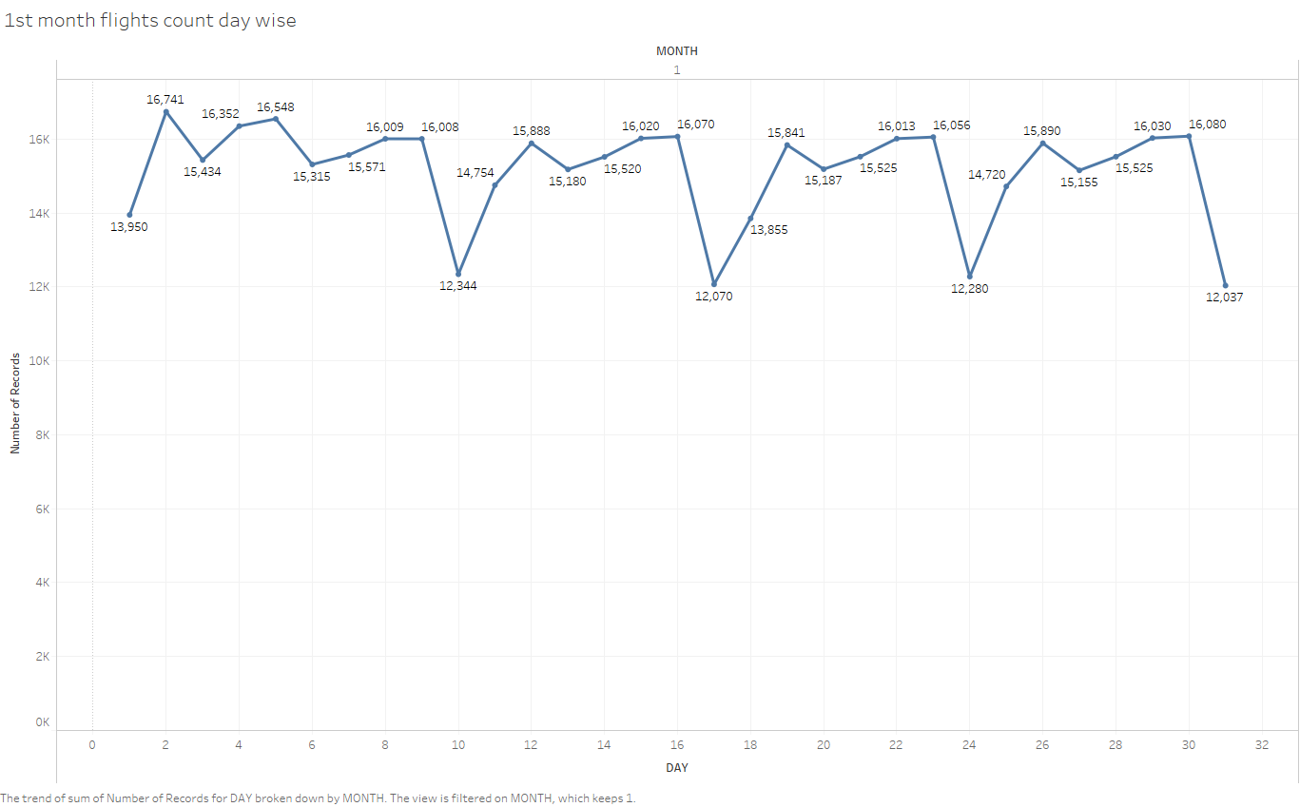
1st month flights count day wise

Slide 71
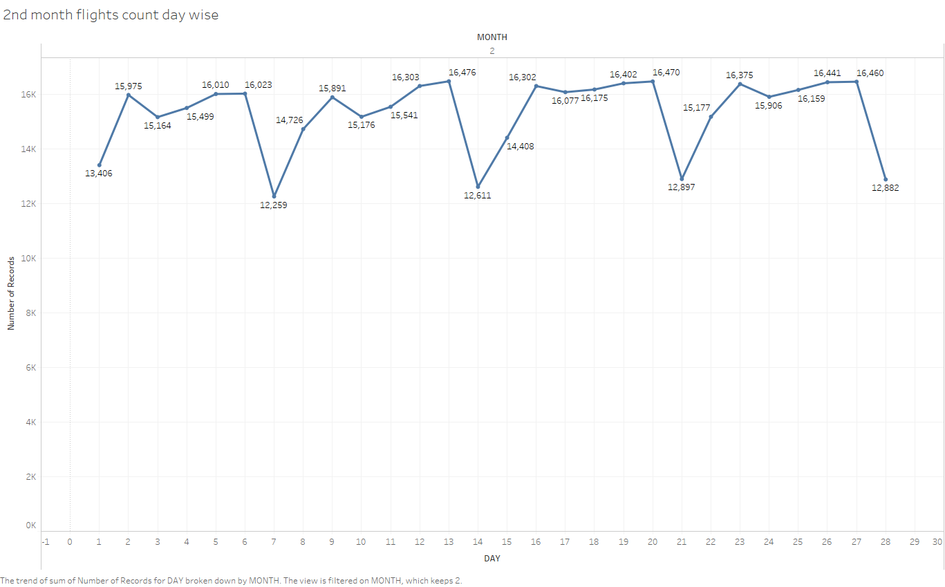
2nd month flights count

Slide 72
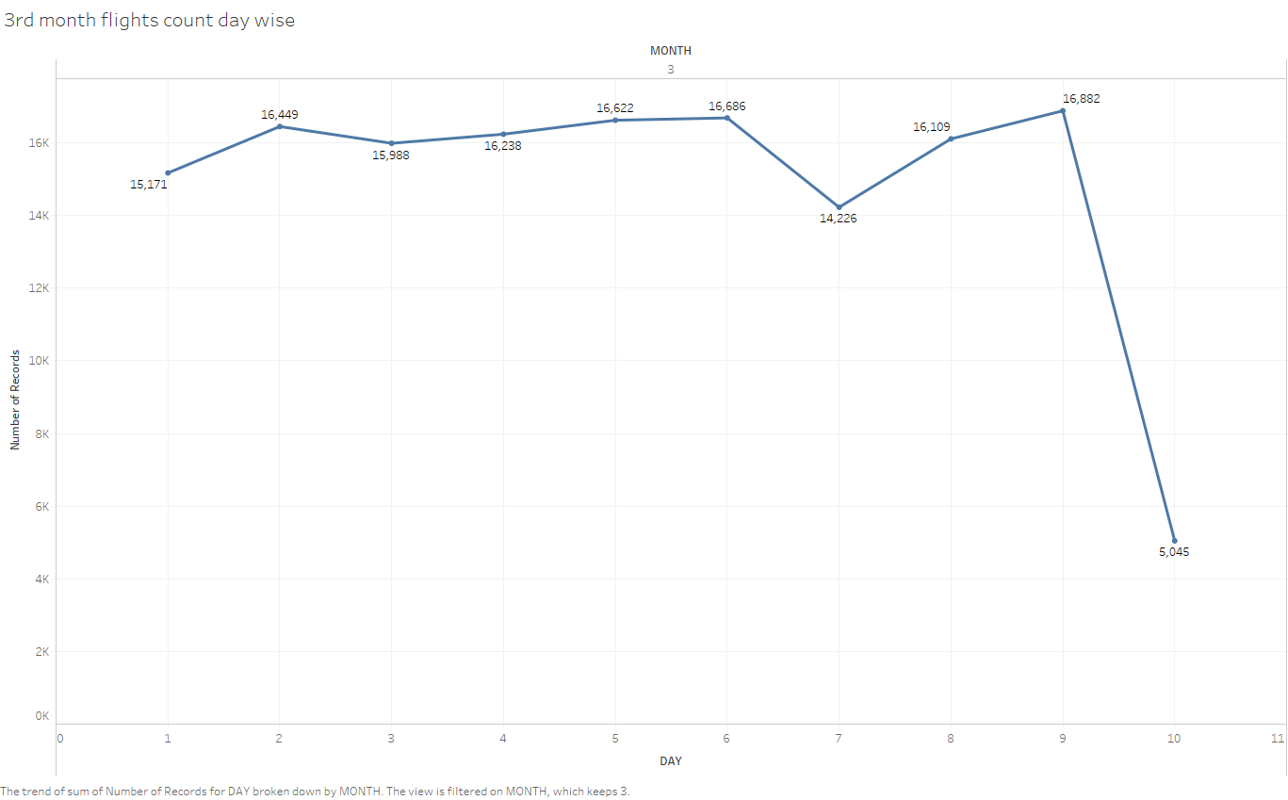
3rd month flights count

Slide 73
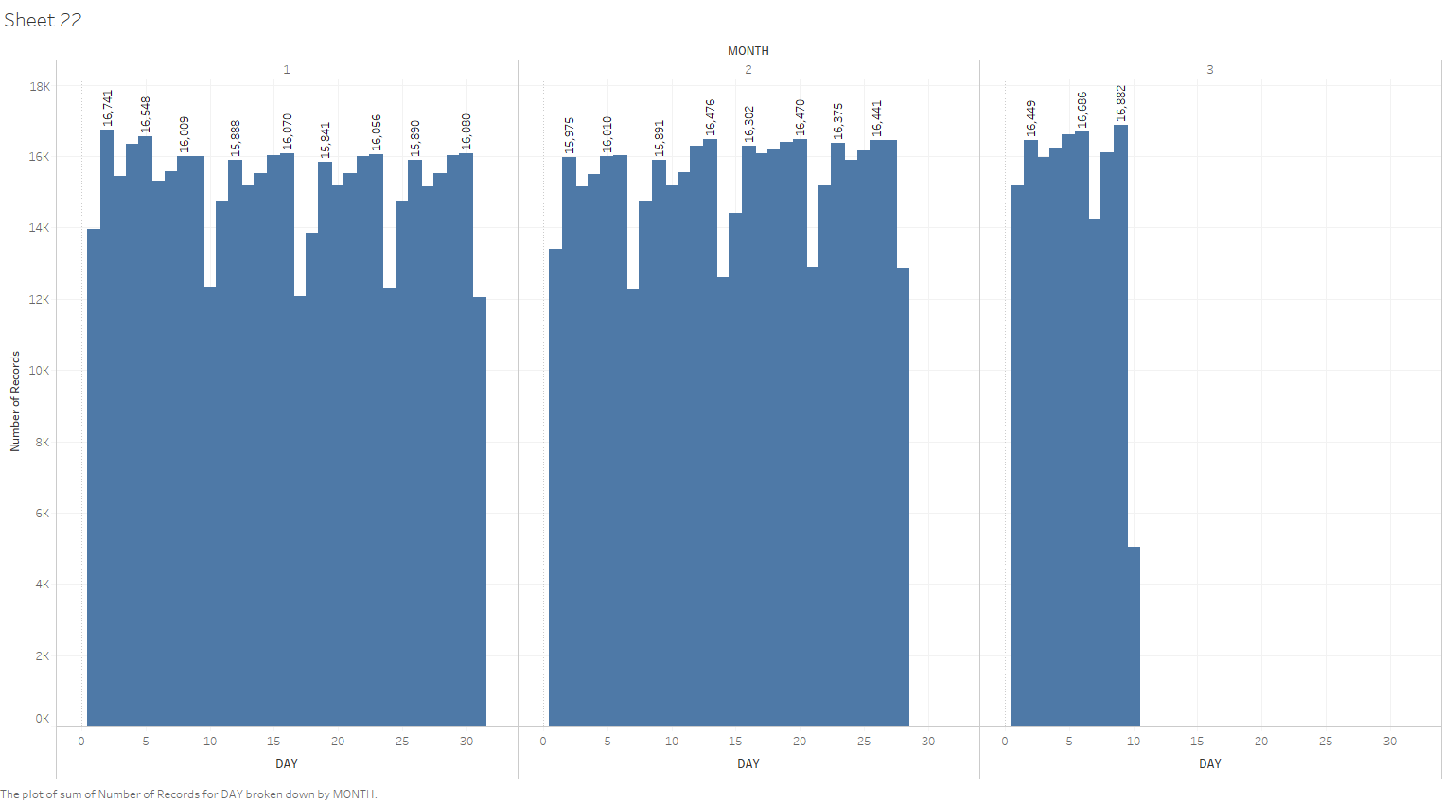
Number of flights with respect to particular month and day

Slide 74
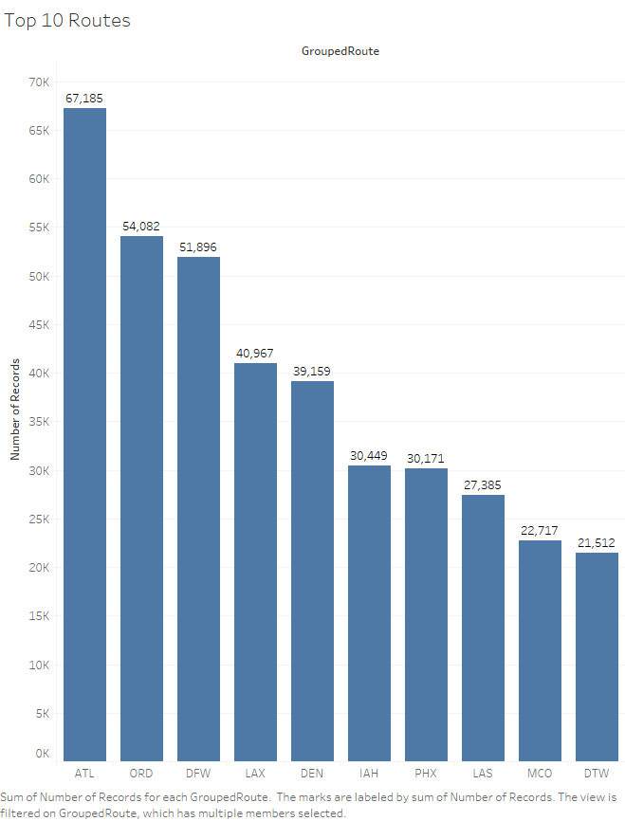
Top 10 routes(Routes with highest number of flights)

Slide 75
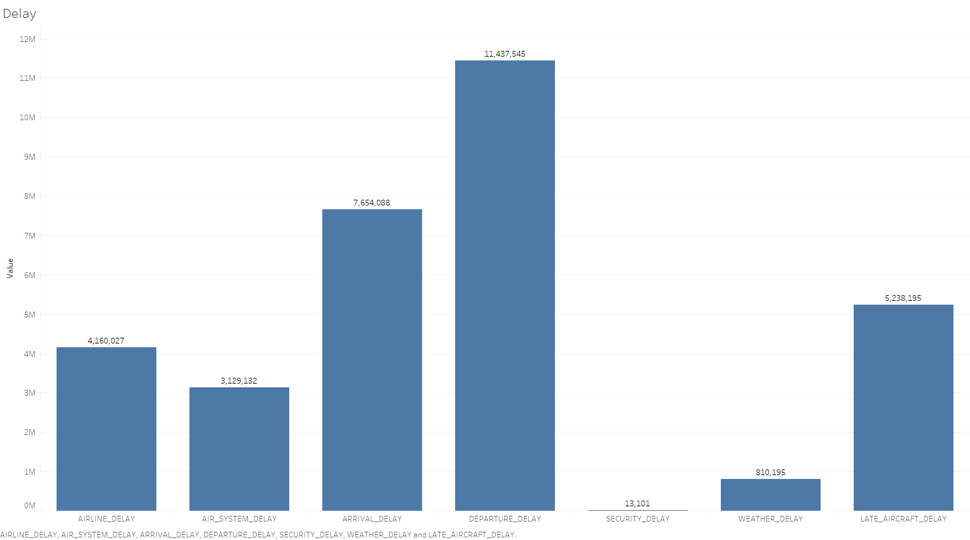
Overall delays

Slide 76
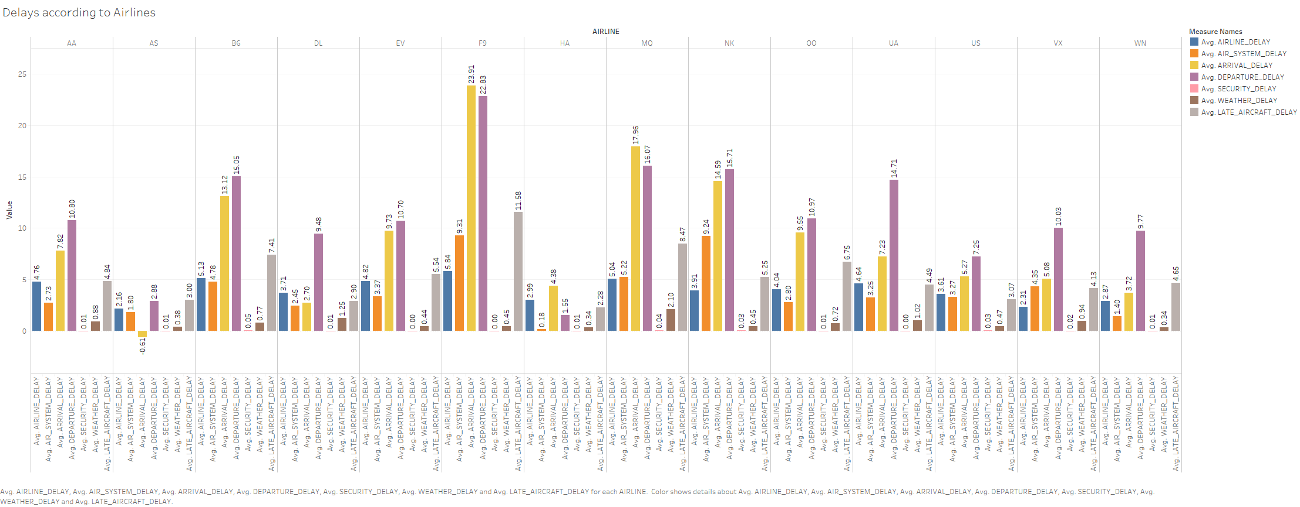
Average(Percentage) delays with respect to airlines

Slide 77
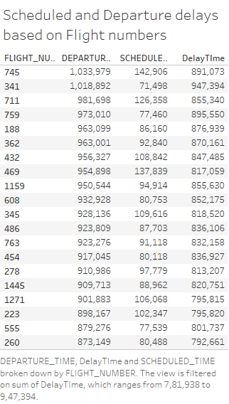
Delay time with respect to flight numbers(Top 20)

Slide 78
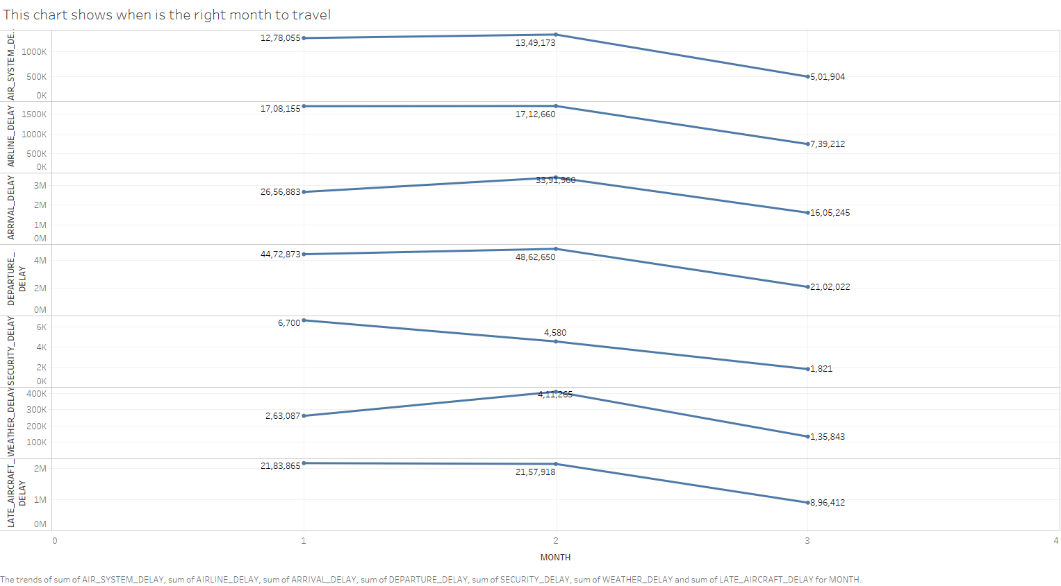
Delay by month with respect to various attributes

Slide 79
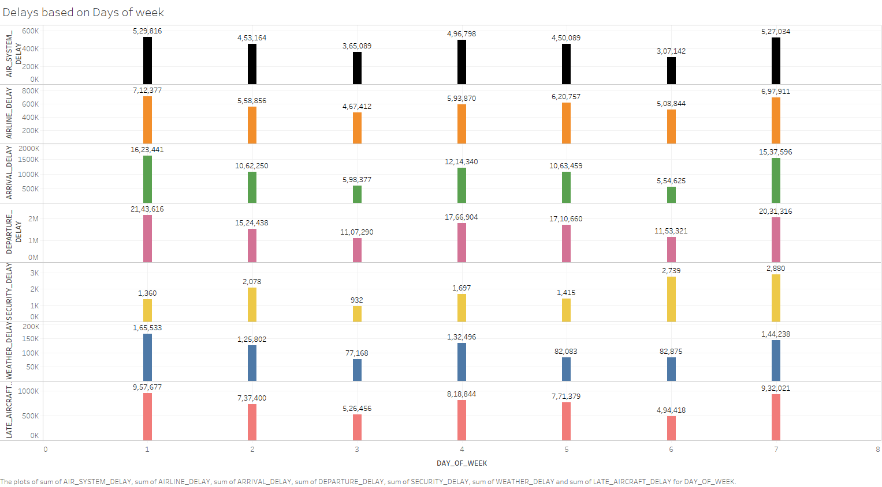
Delays based on weekdays

Slide 80
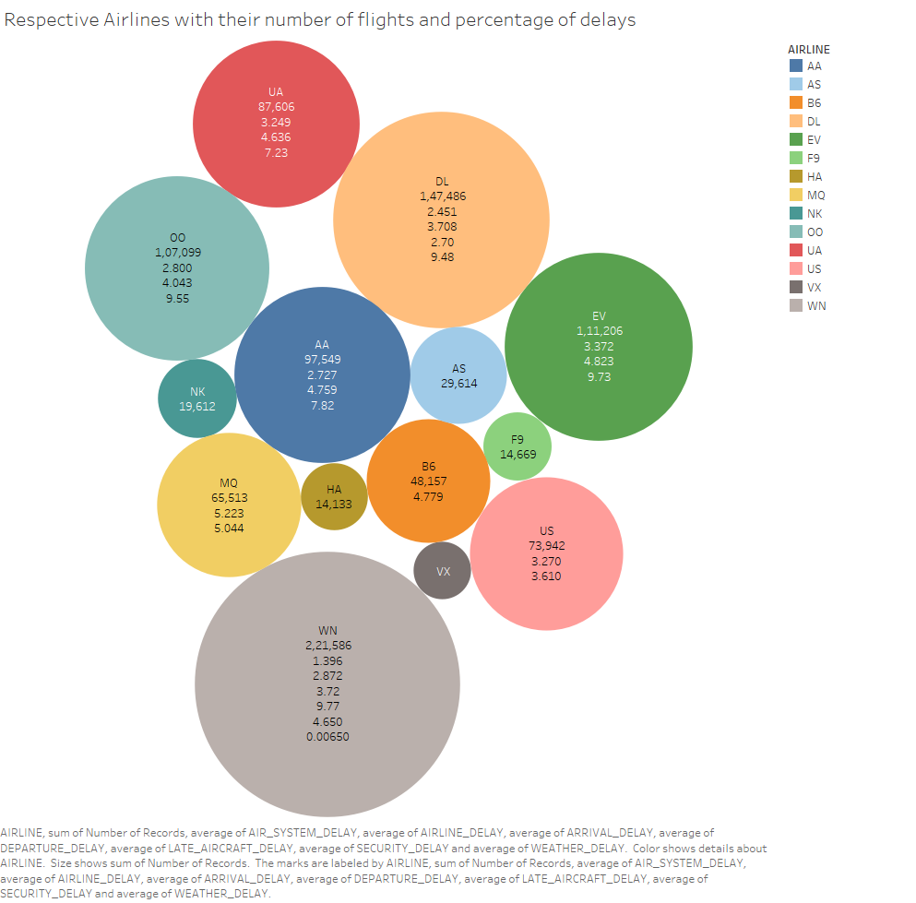
Airlines with total number of flights and average(Percentage) delays

Slide 81
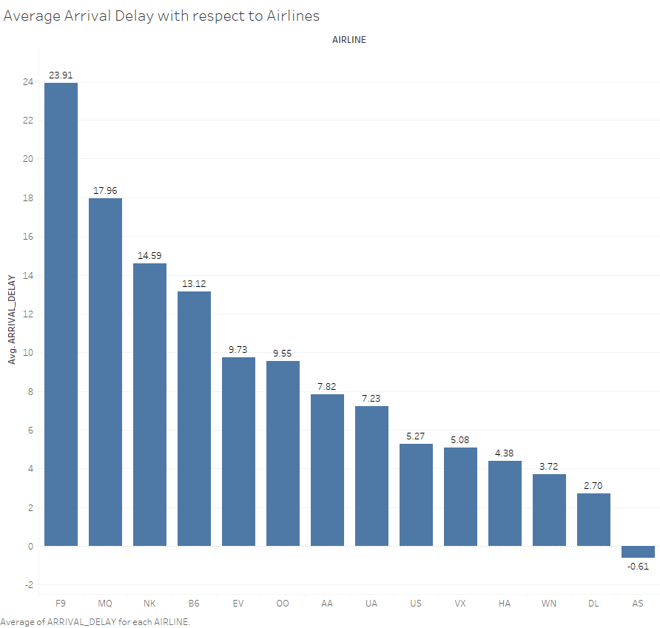
Average Arrival delay with respect to airlines

Slide 82
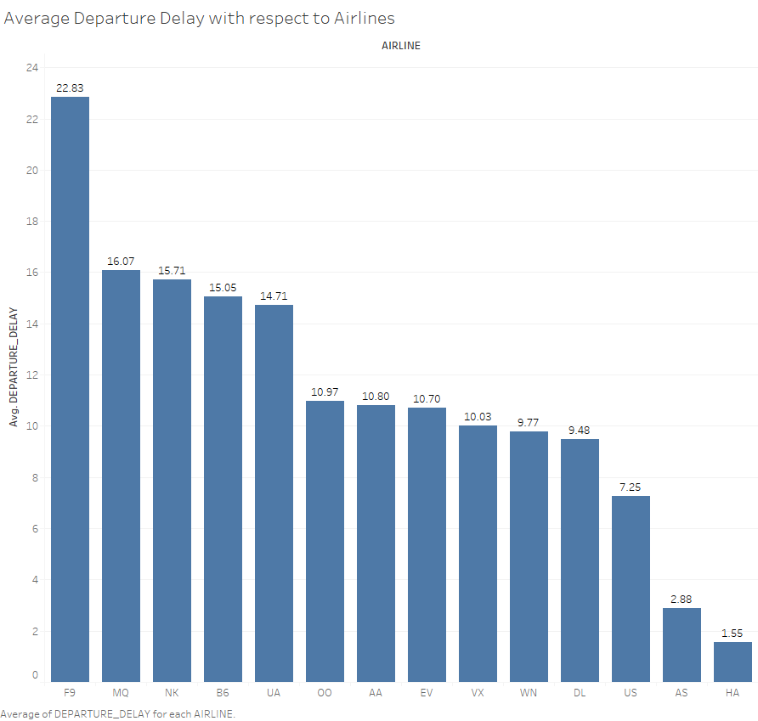
Average departure delay with respect to airlines

Slide 83
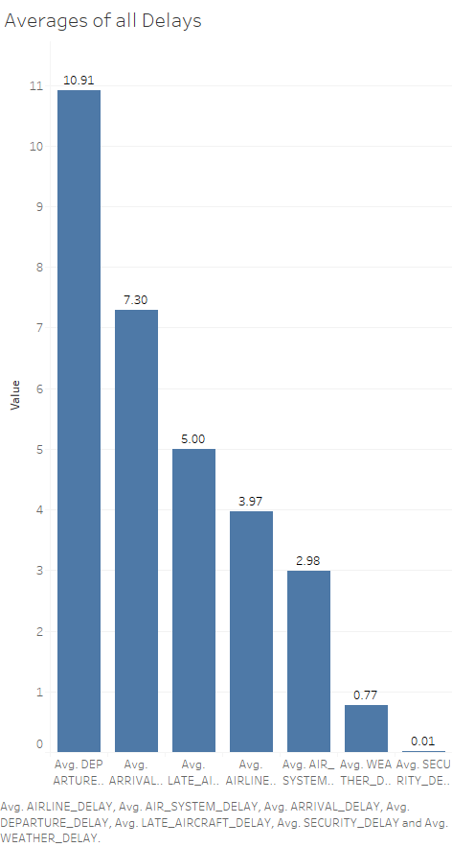
Averages of all delays

Slide 84
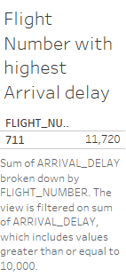
Flight with highest arrival delay

Slide 85
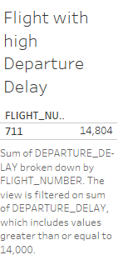
Flight with highest departure delay

Slide 86
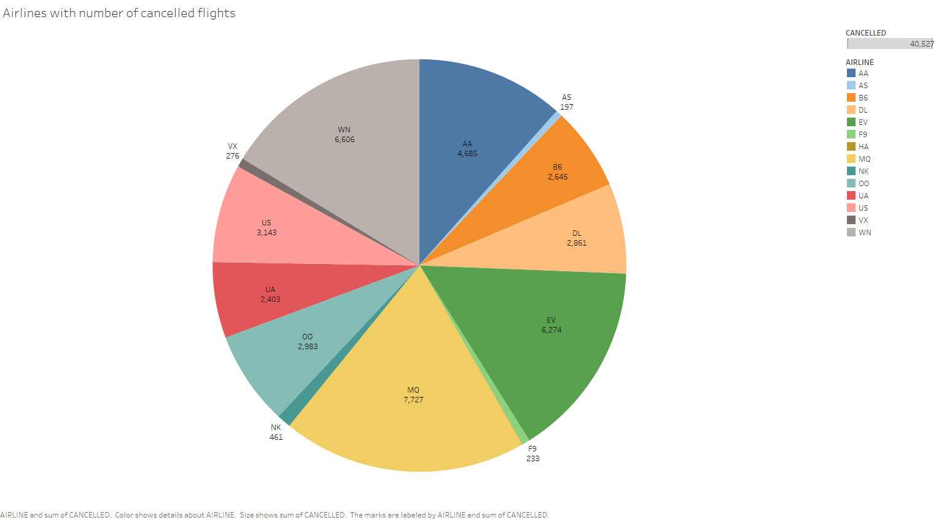
Airlines with total number of cancelled flights

Slide 87
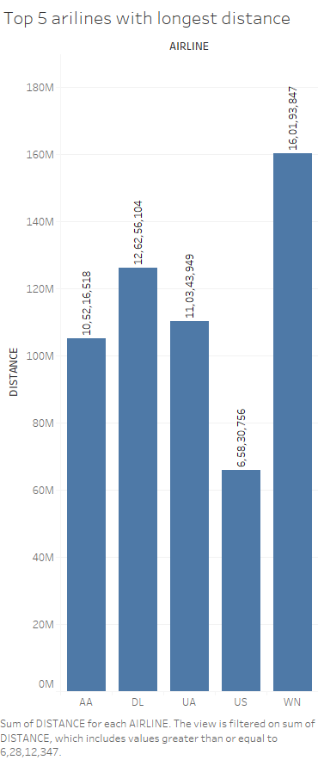
Top 5 distances with respect to airlines

Slide 88
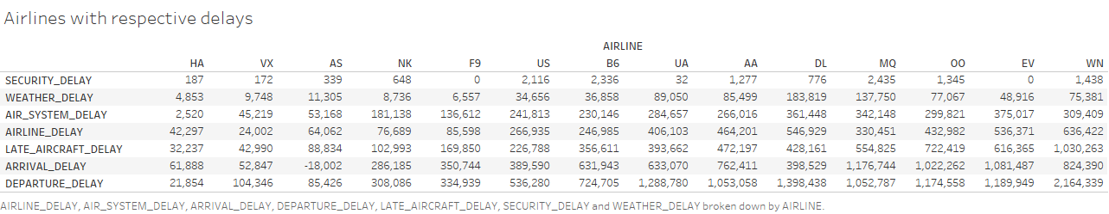
Airlines with respect to delays

Slide 89
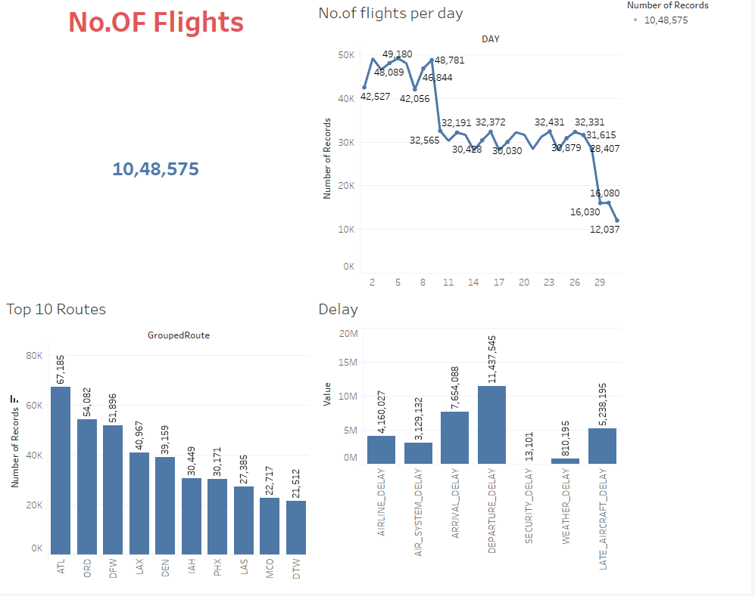
Dashboard - 1

Slide 90
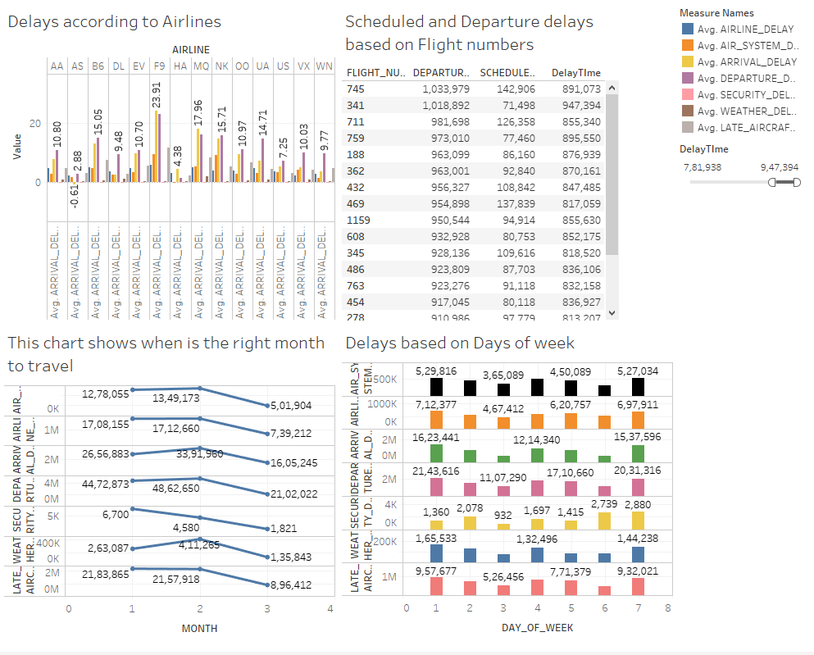
Dashboard - 2

Slide 91
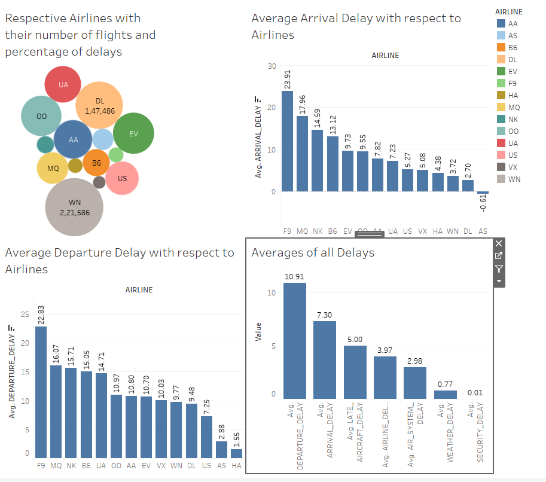
Dashboard - 3

Slide 92
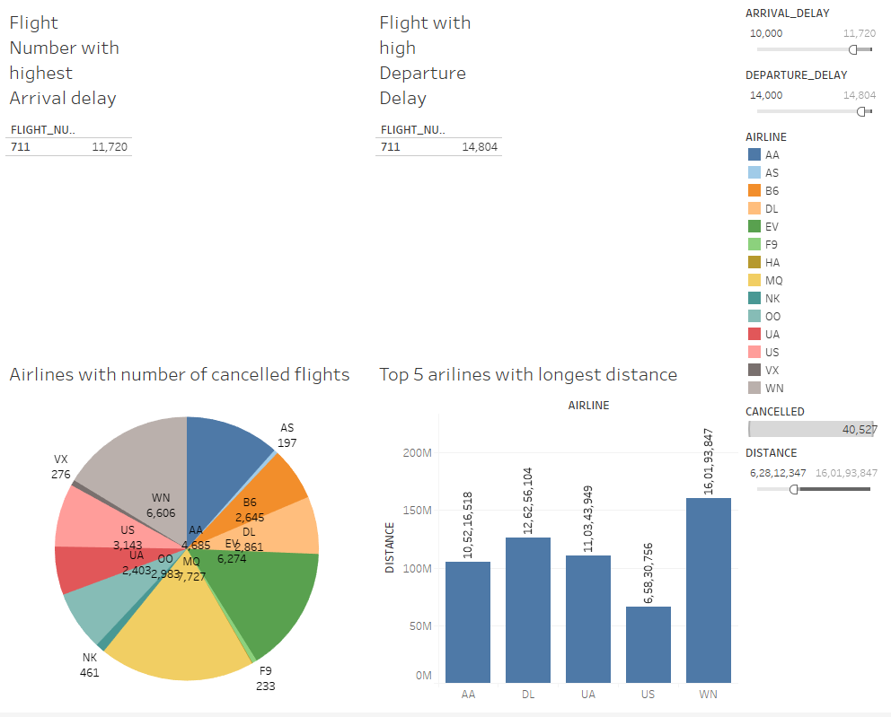
Dashboard - 4

Slide 93
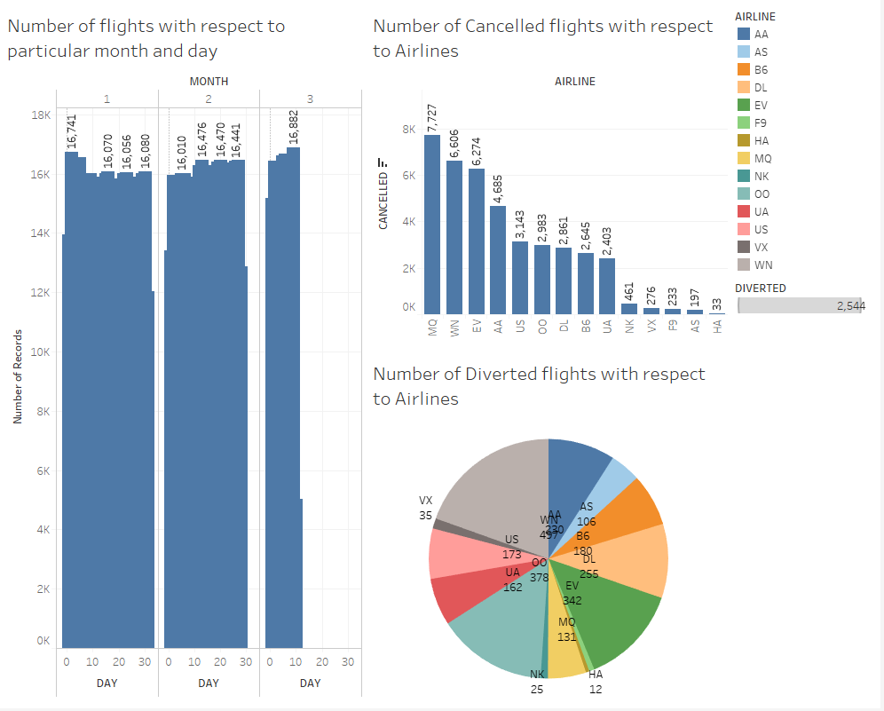
Dashboard - 5

